Slide 1

CAP 6317/4773: Social Media Mining
Lecture 9: Network Models and Data Mining
Raiyan Abdul Baten, Ph.D.
February 6, 2024

Slide 2
Recap

Slide 3

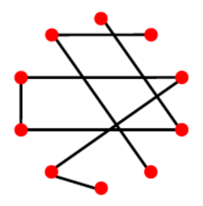
Expected number of edges in G(n,p)
We have ways of picking a pair of nodes
Out of those, p fraction will be realized
So, Average number of edges, m = p

Slide 4
Average degree per node in G(n,p)
A node can connect to at most (n-1) possible peers
Out of those, p edges will be realized on average
So, Average degree per node, c = (n-1)p
p
p
p

Slide 5
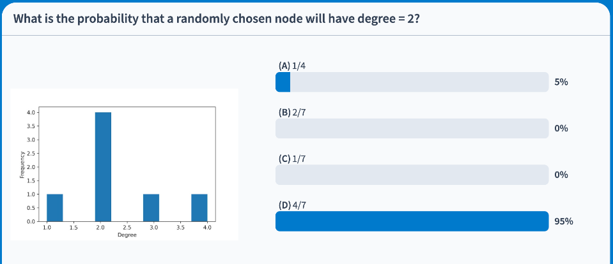



Slide 6


What is the probability that a certain node has exactly degree d=2?
A node can connect to at most (n-1) possible peers
Out of those, d edges can be chosen ways
Probability of having exactly d degrees:

Slide 7
What is the probability that a certain node has exactly degree d=2?
n = 5, d = 2
p = 0.7
p = 0.7
1-p = 0.3
p = 0.7
0.3

Slide 8
What is the probability that a certain node has exactly degree d=2?
n = 5, d = 2
p = 0.7
p = 0.7
1-p = 0.3
p = 0.7
Probability of this configuration happening will be
0.7 * 0.7 * 0.3 * 0.3
0.3

Slide 9
What is the probability that a certain node has exactly degree d=2?
n = 5, d = 2
p = 0.7
p = 0.7
1-p = 0.3
p = 0.7
Probability of this configuration happening will be
0.7 * 0.7 * 0.3 * 0.3
= 0.7² * 0.3²
= 0.7^{d} * 0.3 ^{n-1-d}
0.3

Slide 10
What is the probability that a certain node has exactly degree d=2?
n = 5, d = 2
p = 0.7
p = 0.7
1-p = 0.3
p = 0.7
Probability of this configuration happening will be
0.7 * 0.7 * 0.3 * 0.3
= 0.7² * 0.3²
= 0.7^{d} * 0.3 ^{n-1-d}
= p^{d} * (1-p) ^{n-1-d}
0.3

Slide 11
What is the probability that a certain node has exactly degree d=2?
n = 5, d = 2
p = 0.7
The gray node can connect to at most (n-1)=4 peers

Slide 12
What is the probability that a certain node has exactly degree d=2?
n = 5, d = 2
p = 0.7
The gray node can connect to at most (n-1)=4 peers
Out of those, d=2 edges can be chosen ways
Here, 4 choose 2 = 6 ways

Slide 13
What is the probability that a certain node has exactly degree d=2?
Probability of a node having exactly d degrees:

Slide 14



Take the limit n → ∞ to get the degree distribution for a very large graph:

Slide 15
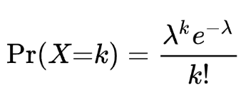
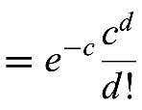

This is the Poisson Distribution!

Slide 16

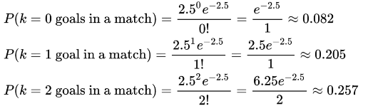
Intuition behind the Poisson Distribution
Average number of goals in a World Cup match c = 2.5 per match
Probabilities of getting exactly d = 0, 1, 2 goals in a match are
d
d
d

Slide 17
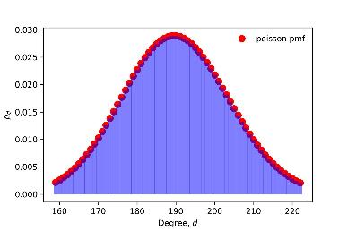
So.. a random graph has Poisson Degree Distribution
Average number of friends on facebook, c = 190 per node
Probabilities of finding nodes with exactly d = 0, 1, 2,... 190, … 5000 friends

Slide 18
A more realistic version: Barabasi-Albert Model
Attempt 1:
Hold network size, n, constant
Inject preferential attachment:
Connect to a vertex v_{j} with probability proportional to v_{j}’s degree centrality
At some point, network becomes fully connected

Slide 19
A more realistic version: Barabasi-Albert Model
Attempt 2:
Allow n to grow: add new nodes!
But connections are random
Does not capture power law properties

Slide 20
A more realistic version: Barabasi-Albert Model
Attempt 3:
Allow n to grow: add new nodes!
Inject preferential attachment:
Connect to a vertex v_{j} with probability proportional to v_{j}’s degree centrality
This time power law distribution is captured!

Slide 21
Reminder to self: Attendance

Slide 22
Reading for today’s lecture: 4.2, 4.3, 4.4

Slide 23
Six Degrees of Separation

Slide 24
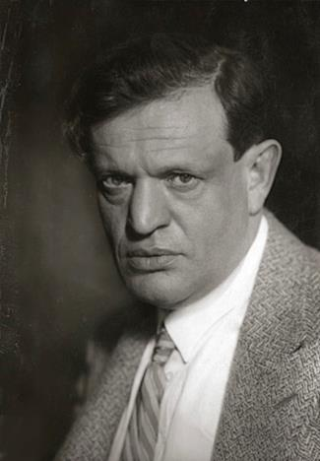
1929
Chains, a short story by Hungarian author and poet Frigyes Karinthy
A character challenges others to find anyone on earth who be cannot connect himself to through fewer than 5 intermediaries
Image from https://commons.wikimedia.org/wiki/File:Karinthy_Frigyes_%C3%ADr%C3%B3.jpg

Slide 25
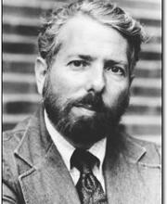
1960
Harvard Psychologist Stanley Milgram
Experimentally tested the idea!
Image from https://psychology.fas.harvard.edu/people/stanley-milgram

Slide 26
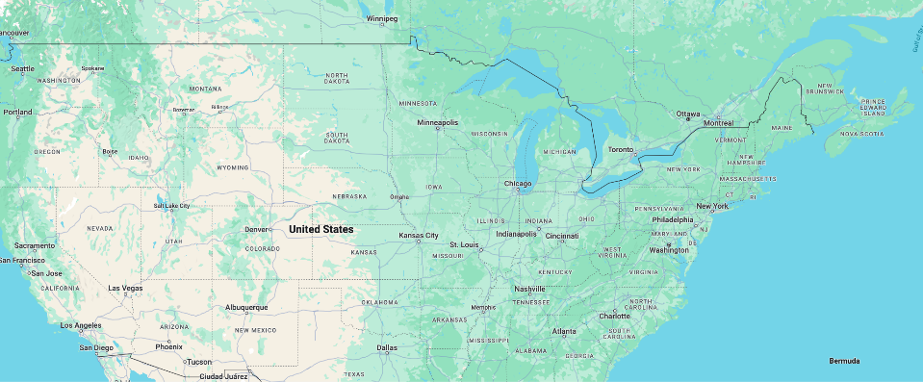
300 packages sent out to people in Nebraska and Boston
You can only forward it to someone you know on a first-name basis
Target: A stockbroker in Boston
100: Live in Boston
100: Stockbrokers
100: Do not live in Boston and are not stockbrokers
Only 64 packets ever made it!
Path length: 5.1

Slide 27
300 packages sent out to people in Nebraska and Boston
You can only forward it to someone you know on a first-name basis
Target: A stockbroker in Boston
100: Live in Boston
100: Stockbrokers
100: Do not live in Boston and are not stockbrokers
Only 64 packets ever made it!
Path length: 5.1

Slide 28
300 packages sent out to people in Nebraska and Boston
You can only forward it to someone you know on a first-name basis
Target: A stockbroker in Boston
100: Live in Boston
100: Stockbrokers
100: Do not live in Boston and are not stockbrokers
Only 64 packets ever made it!
Path length: 5.1

Slide 29
300 packages sent out to people in Nebraska and Boston
You can only forward it to someone you know on a first-name basis
Target: A stockbroker in Boston
100: Live in Boston
100: Stockbrokers
100: Do not live in Boston and are not stockbrokers
Only 64 packets ever made it!
Path length: 5.1

Slide 30
Statistical Characteristics of Networks
Degree Distribution
Clustering Coefficient
Average Path Length
Giant Component

Slide 31
Statistical Characteristics of Networks
Degree Distribution
Clustering Coefficient
Average Path Length
Giant Component

Slide 32
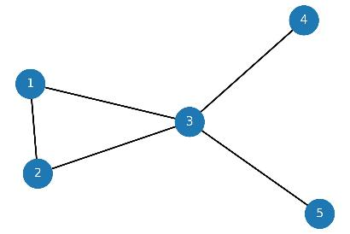
From | To | Shortest paths | Length of the shortest path l_{i,j}
1 | 2 | (1,2) | 1
1 | 3 | (1,3) | 1
1 | 4 | (1,3,4) | 2
1 | 5 | (1,3,5) | 2
2 | 3 | (2,3) | 1
2 | 4 | (2,3,4) | 2
2 | 5 | (2,3,5) | 2
3 | 4 | (3,4) | 1
3 | 5 | (3,5) | 1
4 | 5 | (4,3,5) | 2

Slide 33
From | To | Shortest paths | Length of the shortest path l_{i,j}
1 | 2 | (1,2) | 1
1 | 3 | (1,3) | 1
1 | 4 | (1,3,4) | 2
1 | 5 | (1,3,5) | 2
2 | 3 | (2,3) | 1
2 | 4 | (2,3,4) | 2
2 | 5 | (2,3,5) | 2
3 | 4 | (3,4) | 1
3 | 5 | (3,5) | 1
4 | 5 | (4,3,5) | 2
Average Path Length
Average of shortest path lengths: 1.5

Slide 34
From | To | Shortest paths | Length of the shortest path l_{i,j}
1 | 2 | (1,2) | 1
1 | 3 | (1,3) | 1
1 | 4 | (1,3,4) | 2
1 | 5 | (1,3,5) | 2
2 | 3 | (2,3) | 1
2 | 4 | (2,3,4) | 2
2 | 5 | (2,3,5) | 2
3 | 4 | (3,4) | 1
3 | 5 | (3,5) | 1
4 | 5 | (4,3,5) | 2
Average Path Length
Average of shortest path lengths: 1.5
Diameter
Longest shortest path length: 2

Slide 35
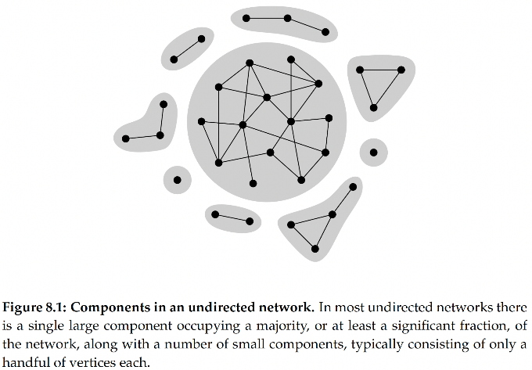
Giant
Component

Slide 36
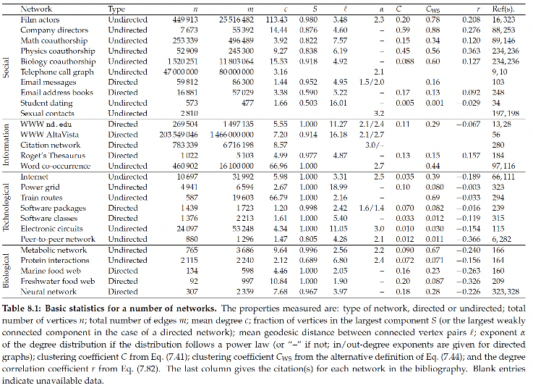

Slide 40
Statistical Characteristics of Real Networks
Degree Distribution
Power Law
Clustering Coefficient
High clustering (global/local)
Average Path Length
Low
Giant Component
Yes

Slide 41
Random Graph Model, G(n,p)
Degree Distribution
Power Law
Clustering Coefficient
High clustering (global/local)
Average Path Length
Low
Giant Component
Yes

Slide 42
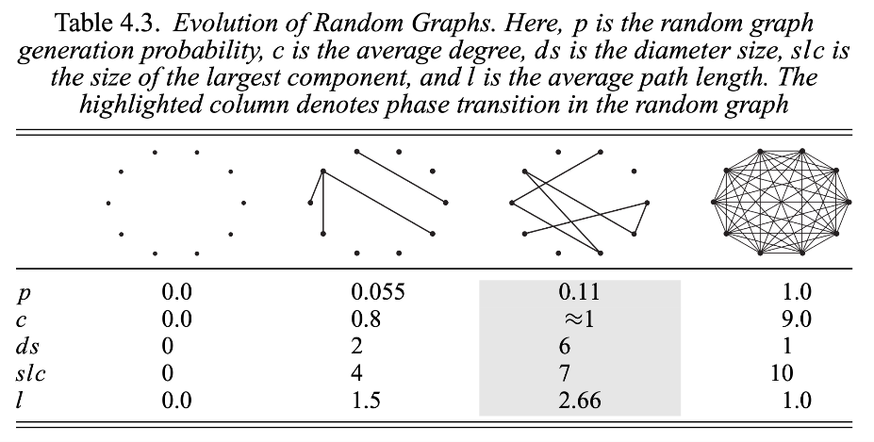

Slide 46
Random Graph Model, G(n,p)
Degree Distribution
Power Law
Clustering Coefficient
High clustering (global/local)
Average Path Length
Low
Giant Component
Yes
…When p is high
But that makes the graph too dense

Slide 47
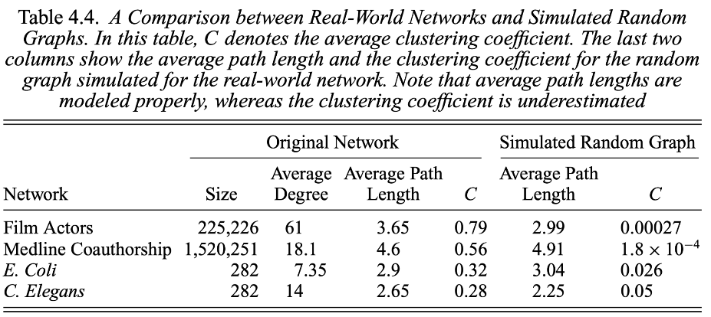

Slide 49
Barabasi-Albert Preferential Attachment Model
Degree Distribution
Power Law
Clustering Coefficient
High clustering (global/local)
Average Path Length
Low
Giant Component
Yes

Slide 50
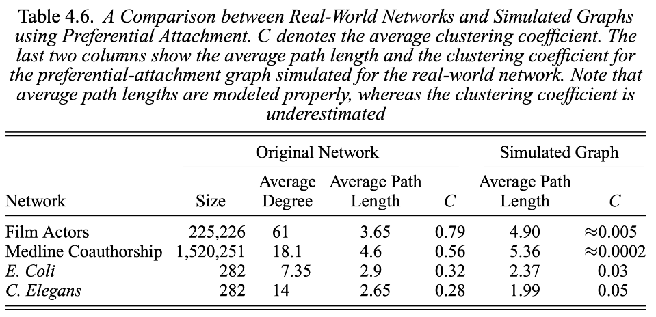

Slide 52
Barabasi-Albert Preferential Attachment Model
Degree Distribution
Power Law
Clustering Coefficient
High clustering (global/local)
Average Path Length
Low
Giant Component
Yes
Triangles rarely get closed!

Slide 53
Watts-Strogatz Small World Model
Degree Distribution
Power Law
Clustering Coefficient
High clustering (global/local)
Average Path Length
Low
Giant Component
Yes

Slide 54
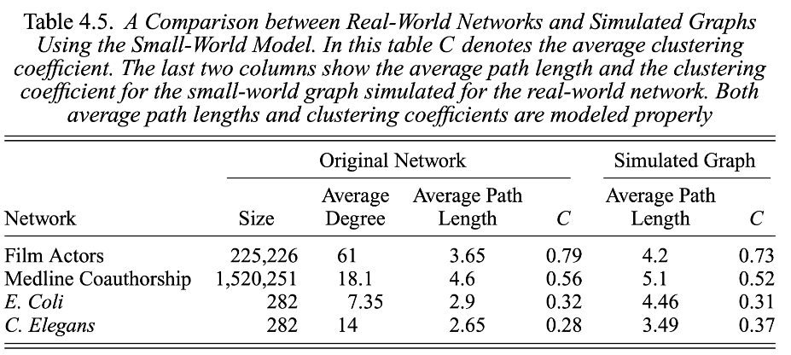

Slide 56
Watts-Strogatz Small World Model
Degree Distribution
Power Law
Clustering Coefficient
High clustering (global/local)
Average Path Length
Low
Giant Component
Yes
Realistic CC and Avg path lengths
Captures the Small World phenomenon!

Slide 57
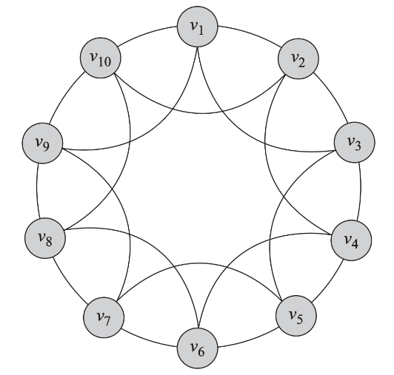

Slide 58
Rewiring probability, p = 0

Slide 59
Rewiring probability, p > 0

Slide 60
Rewiring probability, p > 0

Slide 61
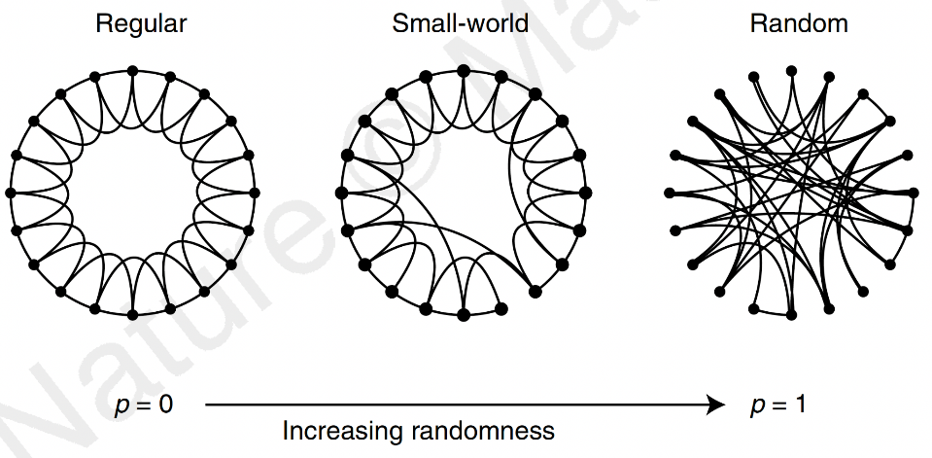

Slide 62
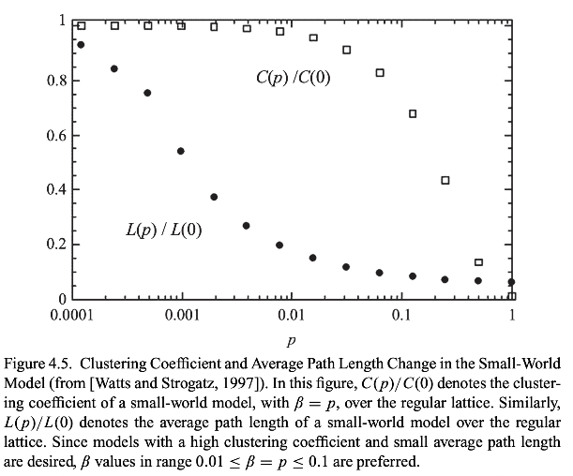

Slide 64
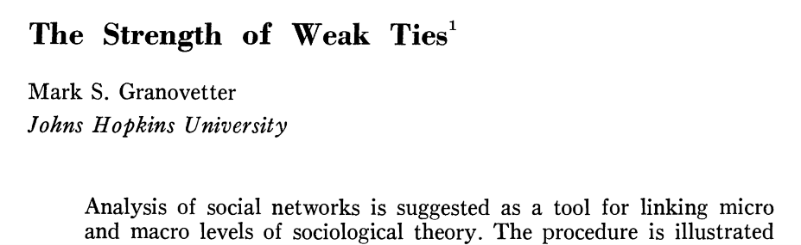

Slide 65
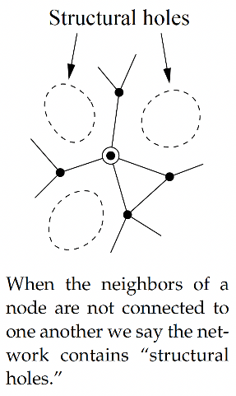

Slide 66
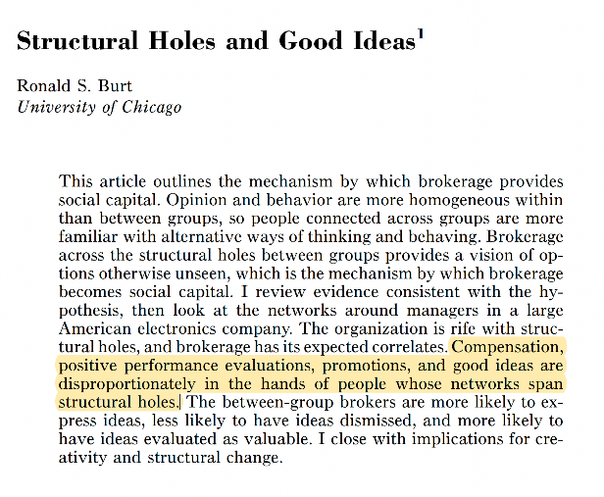

Slide 67
Social Science
Network/computational Science
Let us not forget
Computer science
Machine learning
Ethnography
Mathematics
Optimization
And more!
Social Media Mining
Statistics and Data Mining

Slide 68
Data Mining

Slide 69

Our new smart watch outperforms the old watch by
20%
in terms of sleep tracking accuracy!

Slide 70
But how can we prove it?
This performance improvement could be a mere fluke
Perhaps the old watches happened to be bad copies
Perhaps the participants happened to wear the old watches loosely during their sleeps
…

Slide 71
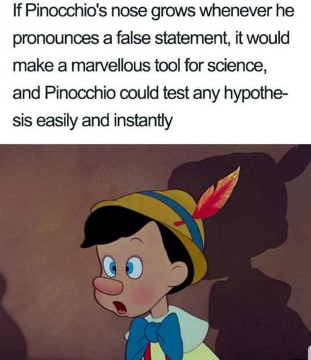

Slide 72
Unfortunately, we don’t have Pinocchio.
We need Quantitative methods to establish the scientific validity of our claims.

Slide 73
So we collect a lot of data
60%
40%
Sleep Tracking Accuracy
20%
New watch
Old watch

Slide 74

So we collect a lot of data
60%
A significant improvement! => 🤑💰💵
Assuming we collected samples correctly and avoided all possible biases in both groups
40%
Sleep Tracking Accuracy
20%
New watch
Old watch

Slide 75
We need a way to summarize our data…
11 users tried the old watch. Against a laboratory-grade sleep tracker, here are the tracking accuracies of this watch:
11, 32, 37, 40, 49, 52, 56, 60, 61, 69, 85

Slide 76
Did anyone say ‘mean’?
11 users tried the old watch. Against a laboratory-grade sleep tracker, here are the tracking accuracies of this watch:
11, 32, 37, 40, 49, 52, 56, 60, 61, 69, 85
Arithmetic mean = (11 + 32 + 37 + 40 + 49 + 52 + 56 + 60 + 61 + 69 + 85) / 11 = 50.18

Slide 77
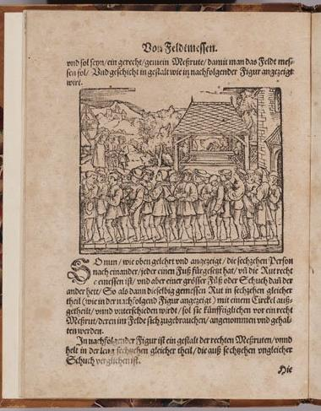
Taking an arithmetic mean is rather radical.
We’re summarizing the data using a value that isn’t present in the data at all!
You can calculate the average height and average weight of a British male, but a person with exactly those measures may not exist in real life. Yet, functionally the mean has been in use for thousands of years (see figure).
Backlash from the scientific community continued even through the 19th century
You’re letting go of too much information. What about the maximum value? The minimum? What about the outliers? We’re not preserving any of these info when we’re summarizing the data using just the mean.
Determination of the lawful rod. Geometry book of Jacob Köbel (1522)
Source: https://www.maa.org/press/periodicals/convergence/mathematical-treasures-jacob-kobels-geometry
Notes:
Average British man vs Average French man

Slide 78
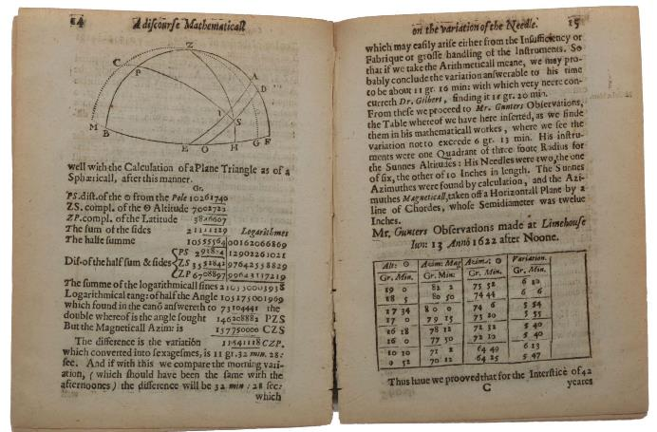
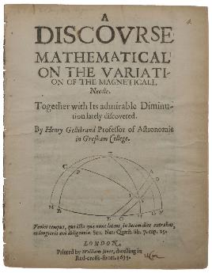
Typically, scientists would just hand-pick their ‘best’ observations instead of averaging all observations. Gellibrand’s “Arithmeticall meane” actually averaged only the maximum and the minimum values. It took hundreds of years to achieve the acceptance of means that we see today!
A discourse mathematical on the variation of the magneticall needle, Henry Gellibrand (1635)
Source: https://www.sophiararebooks.com/pages/books/5121/henry-gellibrand/a-discourse-mathematical-on-the-variation-of-the-magneticall-needle-together-with-its-admirable
Notes:
Usually we’d just take the ‘best’ values. It took a lot of time to formalize arithmetic mean. Wide adoption took even longer.

Slide 79
We need a way to solve the issues with ‘mean’
11, 32, 37, 40, 49, 52, 56, 60, 61, 69, 85
40, 41, 42, 47, 49, 51, 52, 55, 56, 59, 60
The Arithmetic mean is 50.18 in both cases

Slide 80
We need a way to solve the issues with ‘mean’
11, 32, 37, 40, 49, 52, 56, 60, 61, 69, 85
40, 41, 42, 47, 49, 51, 52, 55, 56, 59, 60
The Arithmetic mean is 50.18 in both cases
Yet, the first set of data is much more ‘spread out’ than the second set

Slide 81
Measuring how ‘spread out’ your data is
11, 32, 37, 40, 49, 52, 56, 60, 61, 69, 85
Variance
= 360.15
Standard Deviation
= 18.98

Slide 82
Measuring how ‘spread out’ your data is
11, 32, 37, 40, 49, 52, 56, 60, 61, 69, 85
40, 41, 42, 47, 49, 51, 52, 55, 56, 59, 60
The Arithmetic mean is 50.18 in both cases
The Standard Deviation of the first list is 18.98
The Standard Deviation of the second list is 6.75

Slide 83
Mean and SD together can represent our data
60%
Whiskers denote the SD
40%
Bar height denotes the mean
Sleep Tracking Accuracy
20%
Mean and SD together don’t capture every information about our data, but still gives a reasonable sense of how the data looks like
Old watch

Slide 84


Slide 85
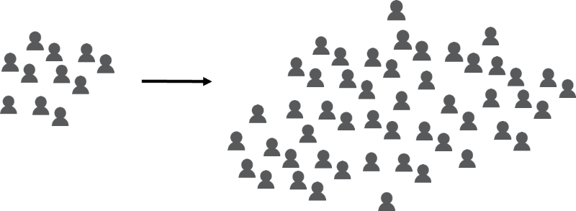
Taking a step back
The Sample
The Population

Slide 86
Taking a step back
The Sample
This gives us the sample mean
E.g., we can calculate vaccine effectiveness on a sample of participants
The Population

Slide 87
Taking a step back
E.g., we care about how the vaccine would perform ‘out in the wild’
We truly care about the population mean
The Sample
This gives us the sample mean
The Population

Slide 88
So far we’ve summarized sample data
60%
Whiskers denote the sample SD
40%
Bar height denotes the sample mean
Sleep Tracking Accuracy
20%
Old watch

Slide 89
Introducing the 95% Confidence Interval (C.I.)
60%
Now the whiskers will denote the 95% C.I.
40%
Bar height still denotes the sample mean
Sleep Tracking Accuracy
20%
Old watch

Slide 90
Introducing the 95% Confidence Interval (C.I.)
60%
Now the whiskers will denote the 95% C.I.
40%
Bar height still denotes the sample mean
Sleep Tracking Accuracy
20%
Intuition
We are 95% confident that the unknown population mean lies within this range around the sample mean
Old watch

Slide 91
Calculating the 95% C.I.
Confidence interval = sample mean ± margin of error

Slide 92
Calculating the 95% C.I.
Confidence interval = sample mean ± margin of error
Example
Sample mean = 80
Margin of error = 3.9
Confidence interval = 80 ± 3.9
Lower limit = 80 - 3.9 = 76.1
Upper limit = 80 + 3.9 = 83.9
Reporting style: 95% C.I. = [76.1, 83.9]

Slide 93
Calculating the 95% C.I.
Confidence interval = sample mean ± margin of error
Example
Sample mean = 80
Margin of error = 3.9
Confidence interval = 80 ± 3.9
Lower limit = 80 - 3.9 = 76.1
Upper limit = 80 + 3.9 = 83.9
Reporting style: 95% C.I. = [76.1, 83.9]
83.9
80
76.1

Slide 94

But how do we get the margin of error?
Confidence interval = sample mean ± margin of error
Confidence interval = sample mean ±

Slide 95
But how do we get the margin of error?
Confidence interval = sample mean ± margin of error
Confidence interval = sample mean ±
Comes from the “Central Limit Theorem”, which connects samples to populations

Slide 96
But how do we get the margin of error?
Confidence interval = sample mean ± margin of error
Confidence interval = sample mean ±
n is the sample size. Easy peasy!

Slide 97
But how do we get the margin of error?
Confidence interval = sample mean ± margin of error
Confidence interval = sample mean ±
𝜎 here is actually the standard deviation of the entire population, which we do not know.
Workaround: just plug in the standard deviation we previously calculated of our data sample. It will work for large enough n.

Slide 98
But how do we get the margin of error?
Confidence interval = sample mean ± margin of error
Confidence interval = sample mean ±
In summary, both of these values can be estimated from the sample we have. Yet, the central limit theorem allows us to make a comment about the population!

Slide 99
But how do we get the margin of error?
Confidence interval = sample mean ± margin of error
Confidence interval = sample mean ±
z* depends on how confident we want to be.
For 95% confidence, z* = 1.96
If you want other confidence levels (e.g., 99% CI), you can look up the respective z* in a table, or the python code can look it up for you

Slide 100
References
The Science of Six Degrees of Separation, Veritasium Youtube Channel
Networks: An Introduction, MEJ Newman

Slide 101
Summary

